Slide 1
Color Model
“illumination models”
RGB, YIQ, CMY, HSV

Slide 2
After going through this unit, you should be able to:
• describe types of light sources and their effects;
• discuss Illumination model
and different reflections covered in this model;
• discuss the concept of shading and its types, and
• describe the concept of Ray tracing and algorithms used.

Slide 3
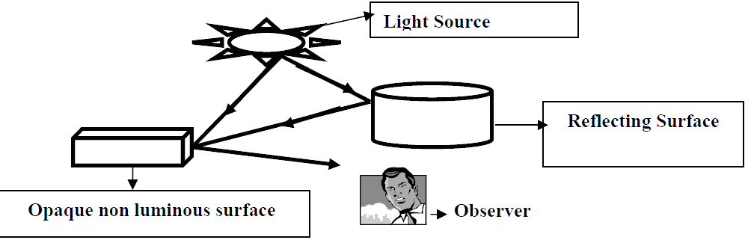
Illumination:
light sources are referred as Luminous objects which are the objects that emit radiant energy.
light emitting source
light reflecting source
illumination is exposure of an object to the light, which contributes to light reflected from an object to our eyes
When we see any object, we see reflected light from that object.
Total reflected light is the sum of contribution from all sources and reflected light from other object that falls on the object.

Slide 4
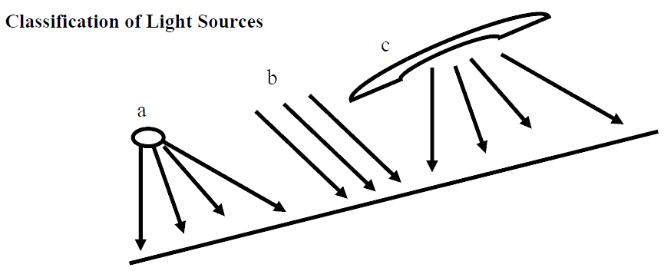
Properties of LIGHT SOURCE
The simplest model for light source is point source.
Example: Sun can be taken as point source on earth.
A long fluorescent light is more accurately modelled as a distributed light source.
When light falls on the surface the part of the light is reflected and part of the light is absorbed.
Amount of reflected and absorbed light depends on the property of the object surface.
Example: shiny surface reflect more light
while dull surface reflect less light.
a-Point source; b-Parallel Source; c- Distributed Source

Slide 5
Local illumination model:
the light that goes directly from the light source and is reflected from the surface.
Global illumination model:
light that is directly reflected from a light source via a surface to our eyes along with the addition of light incident on the surface after multiple reflections

Slide 6
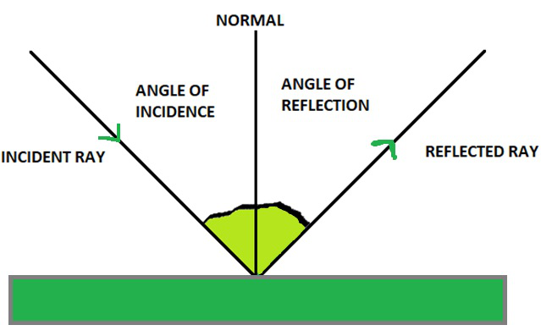
Reflection:
First Law of Reflection: The Incident ray, the Reflected ray and the Normal all lie on the same plane.
Second Law of Reflection: The angle of Incidence is equal to the angle of Reflection.
I for intensity- number of photons incident on a surface in specific time duration.

Slide 7
Interaction of Light and Surface
A surface has 4 types of interaction with light:
Diffuse reflection – light is reflected uniformly with no specific direction
Specular reflection – light is reflected in a specific direction
Diffuse transmission – light is transmitted uniformly with no preferred direction
Specular transmission – light is transmitted in a preferred direction.
Types of reflection
• Ambient Reflection
• Diffuse Reflection
• Specular Reflection
Gouraud shading
Phong shading

Slide 8
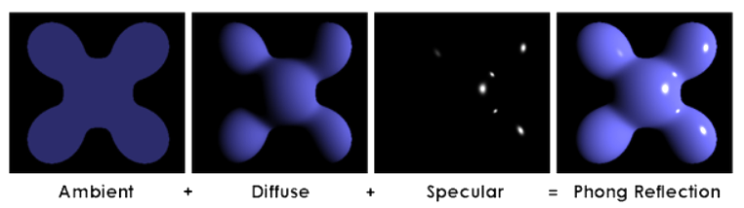
Difference:
ambient light is merely a constant value throughout a scene
result is a sort of matte looking object.
diffuse light is the reflection of light in all directions at a given point
a warmer looking object with a little bit more finish.
specular light is the reflection of light in a single direction, gives a shiny look.
localized part of the object gives it a very shiny finish.

Slide 9
Ambient light
combination of light reflections from various surfaces to produce a uniform illumination is called ambient light (background light).
Ambient light has no directional properties.
The amount of ambient light incident on all the surfaces and object are constant in all direction.
I (Intensity)- (the number of photons incident on a surface in specific time duration).
Consider that 𝐼_{a} → intensity of ambient light;
K_{a} ->( property of material ) Ambient reflection coefficient
If K_{a}​ is 0.5, it means that the material shows 50% of the ambient reflection
the resulting reflected light is constant for all the surfaces
I -> Intensity of reflected ambient light

Slide 10
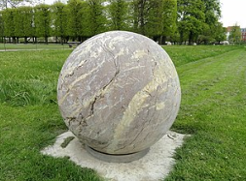
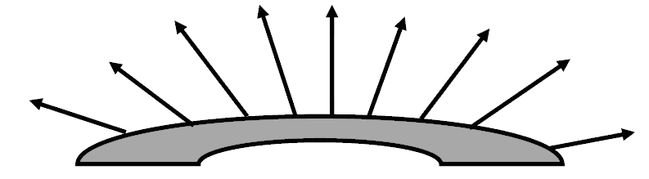
Diffuse reflection
characteristic of light reflected from a dull, non-shiny surface.
surface reflect light in all the direction in equal amount then the resulting reflection is called diffuse reflection.
Ambient light reflection is approximation of global diffuse lighting effects.
Diffuse reflections are constant over each surface independent of our viewing direction.
Amount of reflected light K_{d} ->diffuse réfection coefficient or diffuse reflectivity.
0 < K_{d} < 1 , depending on reflecting property.
Shiny surface reflect more light so K_{d} assign larger value while dull surface assign small value.
Ex- A very rough surface appears equally bright from all viewing directions

Slide 11
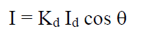
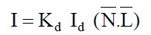
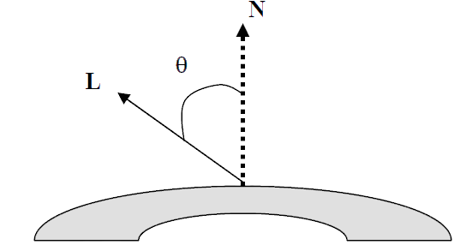
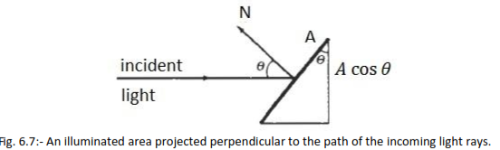
Lambert’s cosine law
Assume: the diffuse reflection from source are scattered with equal intensity in all directions, independent of the viewing direction such a surface are sometimes referred as ideal diffuse reflector or Lambertian reflector.
this law states that the radiant energy from any small surface area dA in any direction Ø𝑛 relative to surface normal is proportional to 𝑐𝑜𝑠Ø𝑛.
K_{d} →diffuse reflection coefficient or diffuse reflectivity. 0 ≤ K_{d} ≤ 1
I_{d} → Intensity of incident diffused light
=>
=>

Slide 12
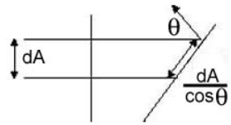
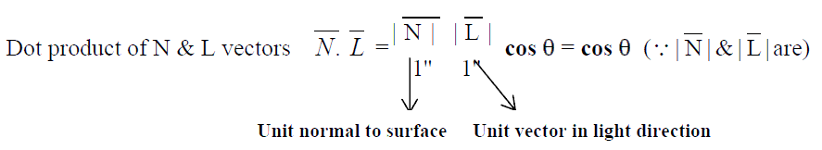
Combined effect of ambient and diffused reflection

Slide 13
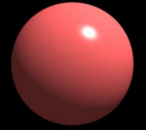
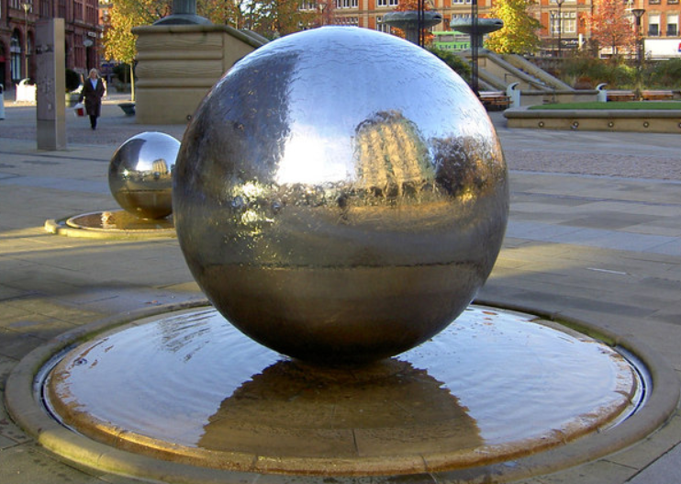
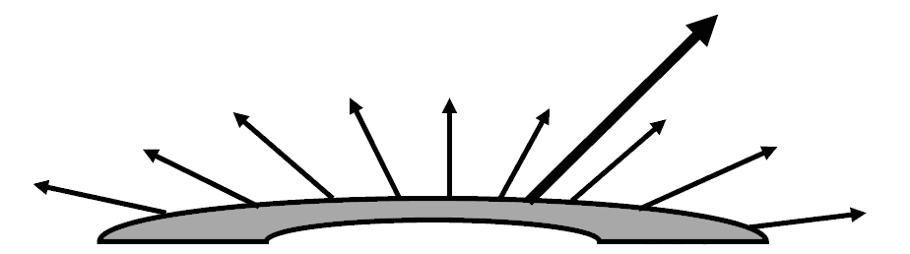
Specular Reflection and the Phong Model.
specular reflection - when the reflection is stronger in one viewing direction, i.e., there is a bright spot, called a specular highlight
such as polished metal we see a highlight, or bright spot, at certain viewing directions.
highlighting is more pronounced on shiny surfaces than on dull surfaces.

Slide 14
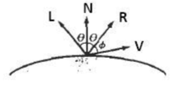
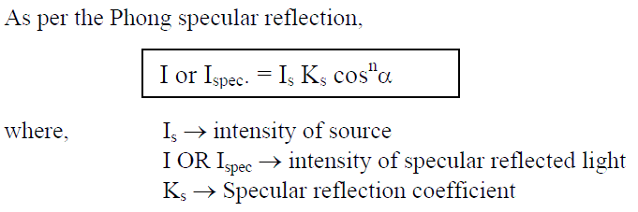
Here, we use R as unit vector in direction of reflection
L is unit vector point towards light vector
N is unit normal vector
and V is unit vector in viewing direction.
Shiny surface have a narrow specular reflection range and dull surface have wide specular reflection range.
By phong specular reflection model sets the intensity of specular reflection proportional to 𝑐𝑜𝑠^{𝑛𝑠} Ø. Angle Ø varies in between 0⁰ to 90⁰
Values assigned to specular reflection parameter ns is determined by the type of surface that we want to display.
A shiny surface assigned ns values large nearly 100
and dull surface assigned small nearly 1.

Slide 15
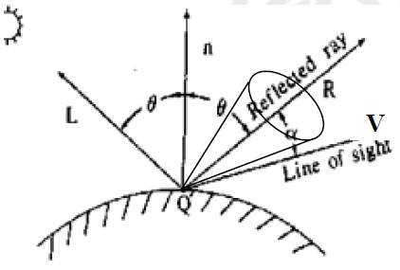
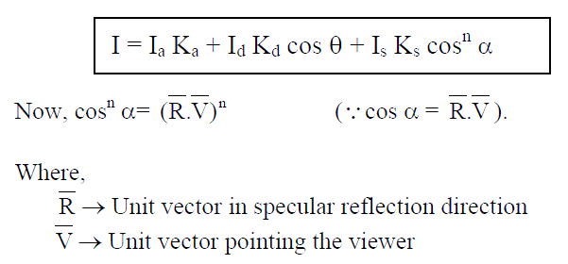
resulting intensity in the case when all ambient/diffuse/ specular reflection occurs is
For Demo:
https://math.hws.edu/graphicsbook/c4/s1.html

Slide 16
shading and rendering techniques
illumination- colour a single pixel.
Shading- Color the entire surface.
3 types of shading
Constant intensity shading OR Flat shading
single intensity is calculated for each polygon surface
Gouraud shading OR Intensity interpolation scheme
Phong shading OR Normal vector interpolation shading.

Slide 17
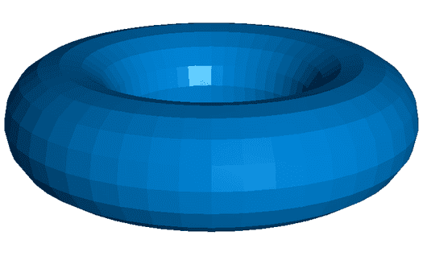
Flat shading
Characteristics of flat shading:
Calculation: One lighting calculation per polygon
Appearance: Produces a faceted look with sharp edges between polygons, as each face has a uniform color
Performance: Fastest among the three techniques, as it involves the least number of calculations
Use case: Suitable for simple, low-polygon models where a faceted look is acceptable or desired

Slide 18
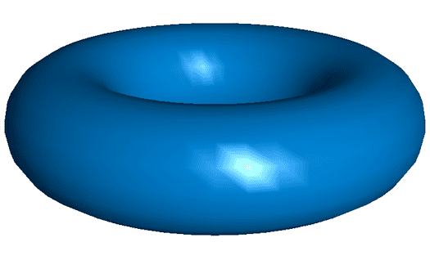
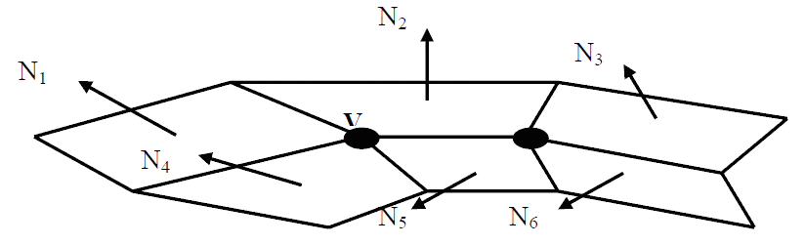
Gouraud shading OR Intensity interpolation scheme
polygon is rendered by linearly interpolating intensity values across the surface
1) Determine average unit normal vector at each polygon vertex.
2) Apply illumination model to each vertex to calculate the vertex intensity.
3) Linearly interpolate the vertex intensities over the surface of the polygon.

Slide 19
Advantages of Gouraud Shading: It removes the intensity discontinuities associated with the constant shading model.
Deficiencies: Linear intensity interpolation can cause bright and dark streaks called Mach bands to appear on the surface, these mach bands can be removed by using Phong shading or by dividing the surface into greater number of polygon faces.

Slide 20
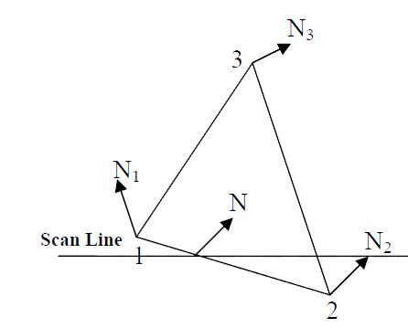
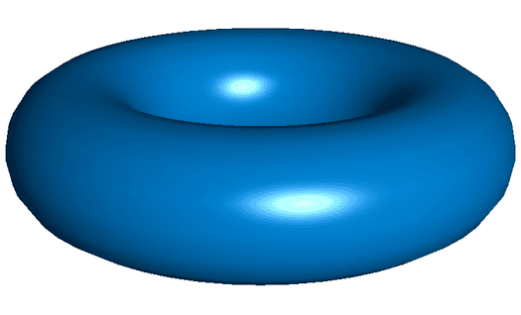
Phong shading OR Normal Vector Interpolation Shading
Calculations involved with Phong Shading:
i) Determine average unit normal vector at each polygon vertex.
ii) Linearly interpolate the vertex normals over the surface of polygon.
iii) Apply illumination model along each scan line to calculate projected pixel intensities for surface points.

Slide 21
Merit
So, by finding intensities at different points across the edge we find that intensity is varying across the edge between two vertex points and is not uniform as in Gouraud Shading, giving much better effect. So, we can say that the normal vector interpolation (Phong shading) is superior to intensity interpolation technique (Gouraud Shading) because it greatly reduces the mach bands.
Demerit: Requires lot of calculations to find intensity at a point, thus increases the cost of shading in any implementation.

Slide 22
Feature/ Aspect | Flat Shading | Gouraud Shading | Phong Shading
Calculation point | Per polygon | Per vertex | Per pixel
Method | Single lighting calculation for the entire polygon | Lighting calculations at vertices, interpolated across the polygon | Interpolated normals, lighting calculated at each pixel
Color calculation | Uniform color across the polygon | Interpolated color from vertices across the polygon | Color calculated at each pixel for detailed shading
Appearance | Faceted look with sharp edges between polygons | Smooth transitions between colors, reduces faceted look | Smooth, realistic shading with accurate highlights and reflections
Performance | Fastest due to minimal calculations | Moderate speed, more calculations than Flat but fewer than Phong | Slowest due to per-pixel calculations and normal interpolation
Visual Quality | Low, with visible polygon edges | Moderate, with smoother color transitions | High, with realistic rendering and smooth gradients
Use Cases | Suitable for low-polygon models, simple graphics | Real-time rendering, video games, moderate detail models | High-quality renderings, animations, detailed models
Advantages | – Very fast | – Good balance between quality and performance | – High realism
 | – Low computational cost | – Smoother appearance than Flat | – Accurate highlights and reflections
Disadvantages | – Faceted appearance | – Still not perfectly smooth | – High computational cost
 | – Low realism | – Not as detailed as Phong | – Slower performance

Slide 23
Q- Phong shading is better than Gouraud shading?
Reason being that in Gouraud Shading the consideration of average normal, the intensity is uniform across the edge between two vertices and this causes problem in shading.
Deficiencies of Gouraud Shading are overcome in Phong Shading, where we are finding intensities at different points across the edge and it is observed that intensity is varying non- uniformly across the edge between two vertex points, but this variation is uniform in Gouraud Shading.
Thus Phong shading gives much better effect.

Slide 24
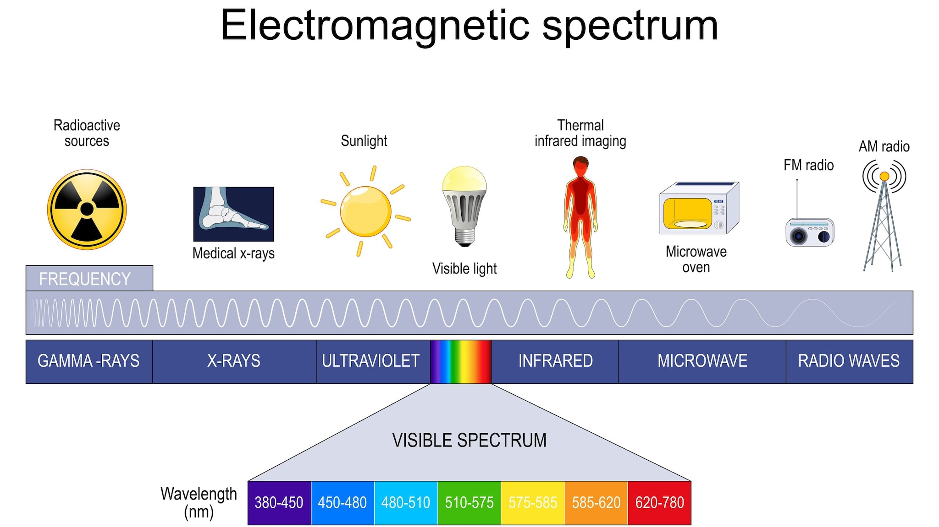

Slide 25
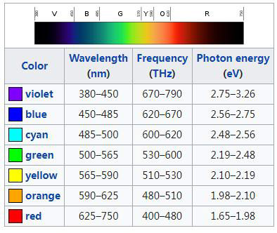
Light
Light is an electromagnetic wave.
Visible light have narrow band in electromagnetic spectrum nearly 400nm to 700nm.
The frequency of visible light ranges from 400–790 terahertz (THz)
We can specify different color by frequency f or by wavelength λ of the wave.
relation between f and λ :
𝑐 = λf
where c is the speed of light (3x10⁸m/s in vacuum).

Slide 26
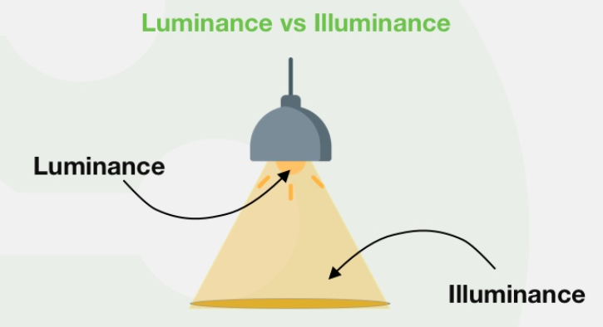
Properties of light
Brightness is how much light we perceive from a source,
while luminance is the amount of light that is emitted from a surface.
Luminance is a measurable quantity,
while brightness is a subjective experience.
two properties purity and dominance define the term chromaticity
Its attributes are hue, saturation, lightness and brightness of different colors.

Slide 27
Color
Additive Color
It is obtained by adding together lights of different colors. The absence of all colors is black while the presence of all colors is white. It works with emitted light.
Subtractive Color
It is obtained by subtracting lights of different colors.
The absence of all colors is white while the presence of all colors is black. It works with reflected light.
Color Representations
There are basically three modes of representing color combinations on a display:
»Palette: An indexed array representing the amounts of R, G, and B to be used to represent the color at the specified pixel.
»Hi-Color: Uses 16 bits to represent colors, thus allowing 64K colors to be displayed.
»True-Color: uses 24 bits (3 bytes) to represent colors, thus allowing 256*256*256 colors to be displayed.

Slide 28
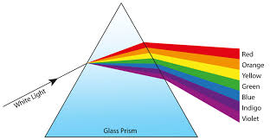
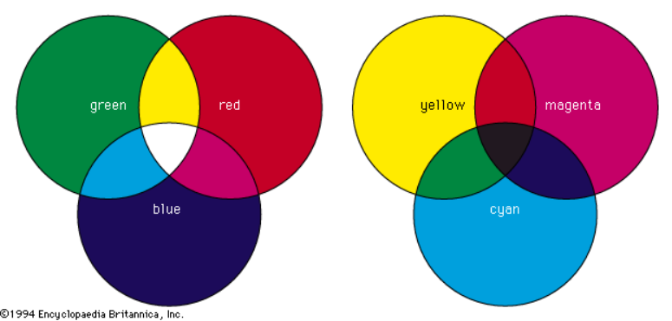
Color Spectrum
When white light is passed through an ordinary prism, it spreads out into a spectrum of colours.
These colours —violet, indigo, blue, green, yellow, orange, and red —make up what is called the visible spectrum of light.

Slide 29

Grayscale
• Black = 0% brightness, 100% gray.
• White = 100% brightness, 0% gray.
• Gray is most often specified from white = 0, thus 10% grey = 90% brightness.
https://colortutorial.design/index.html

Slide 30
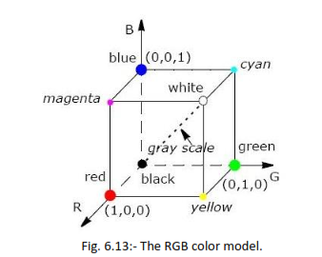
RGB color model
These visual pigments in our retina have a peak sensitivity at wavelengths of about 630 nm (red), 530 nm (green) and 450 nm (blue).
the manner in which the brain responds to visual stimuli
The basis for displaying color output on a video monitor using the 3 primary colors- red, green, and blue.
RGB in LCD & LED Display-
RGB In Cameras- Digital cameras for photography that use a CMOS or CCD image sensor.
RGB In Image Scanner-
The origin (0, 0, 0) is considered black and the diagonally opposite corner (1, 1, 1) is called white.
The line joining black to white represents a gray scale and has equal components of R,G,B.

Slide 31
this model is represented as unit cube.
Origin represent black color and vertex (1,1,1) is white.
Vertex of the cube on the axis represents primary color R, G, and B.
Since, it is bounded in between unit cube, it’s values vary in between 0 to 1 and represented as triplets (R,G,B).
Ex: magenta color is represented with (1,0,1).
Shades of gray are represented along the main diagonal of cube from black to white vertex.
For half way gray scale we use triplets (0.5,0.5,0.5).
The magenta vertex is obtained by adding red and blue to produce the triple (1,0,1) and white at (1,1,1) in the sum of the red, green and blue vertices.
Shades of gray are represented along the main diagonal of the cube from the origin (black) to the white vertex.

Slide 32
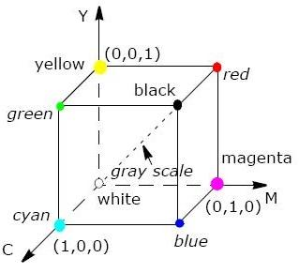
CMY color model
The primary colors cyan, magenta, and yellow (CMY) is useful for describing color output to hard copy devices.
It is a subtractive color model (i.e.,) cyan can be formed by adding green and blue light.
When white light is reflected from cyan-colored ink, the reflected light must have no red component. i.e., red light is absorbed or subtracted by the link.
Magenta ink subtracts the green component from incident light and yellow subtracts the blue component.
CMY+K is used for hardcopy printing by coating a paper with color pigments.
The origin represents white light.
Unit cube for CMY model

Slide 33
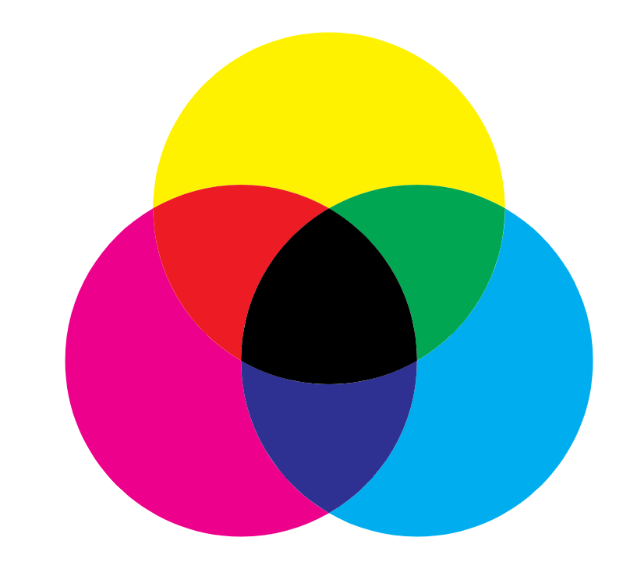
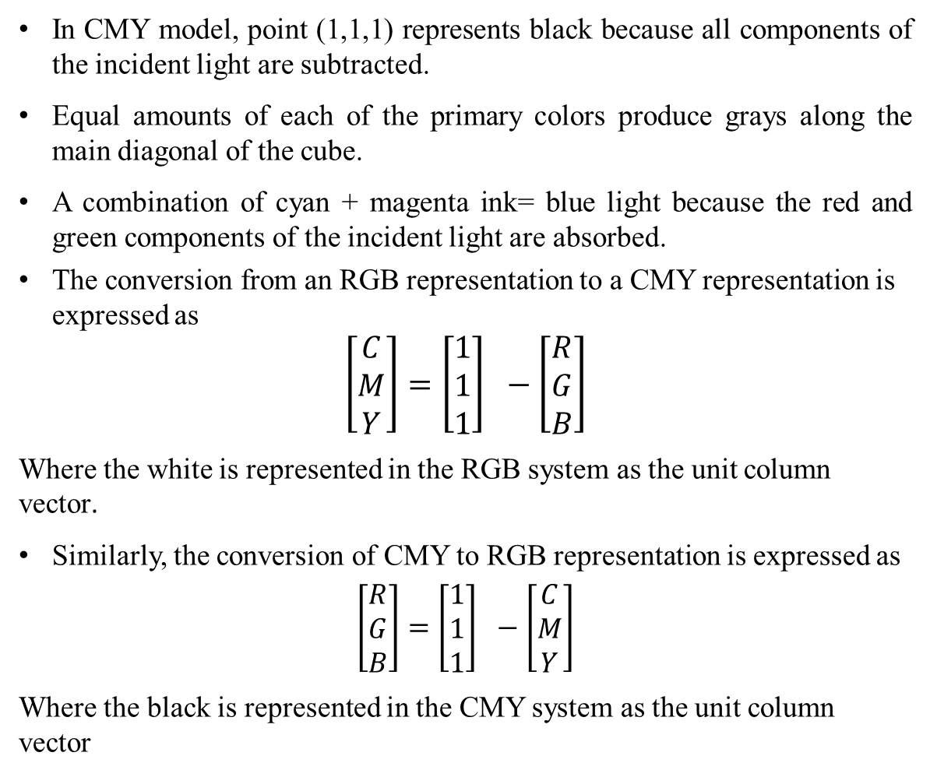
Continued…
In CMY model, point (1,1,1) represents black because all components of the incident light are subtracted.
Equal amounts of each of the primary colors produce grays along the main diagonal of the cube.
A combination of cyan + magenta ink= blue light because the red and green components of the incident light are absorbed.
The conversion from an RGB representation to a CMY representation is expressed as
$$\left[\begin{matrix}C \\ M \\ Y\end{matrix}\right]=\left[\begin{matrix}1 \\ 1 \\ 1\end{matrix}\right] −\left[\begin{matrix}R \\ G \\ B\end{matrix}\right]$$
Where the white is represented in the RGB system as the unit column vector.
Similarly, the conversion of CMY to RGB representation is expressed as
$$\left[\begin{matrix}R \\ G \\ B\end{matrix}\right]=\left[\begin{matrix}1 \\ 1 \\ 1\end{matrix}\right] −\left[\begin{matrix}C \\ M \\ Y\end{matrix}\right]$$
Where the black is represented in the CMY system as the unit column vector

Slide 34
YIQ Color model
RGB monitors requires separates signals for red, green, and blue component of an image but television monitors uses single composite signals.
the color space used by the analog NTSC color TV system
National Television System Committee (NTSC)
In YIQ color model, luminance (brightness) information in contained in the Y parameter (enough for black and white TV), chromaticity information (hue and purity) is contained into the I and Q parameters.
A combination of red, green and blue intensities are chosen for the Y parameter to yield the standard luminosity curve.
Since Y contains the luminance information, black and white TV monitors use only the Y signal.
Parameter I contain orange-cyan hue information that provides the flash-tone shading and occupies a bandwidth of 1.5 MHz.
Parameter Q carries green-magenta hue information in a bandwidth of about 0.6 MHz.

Slide 35
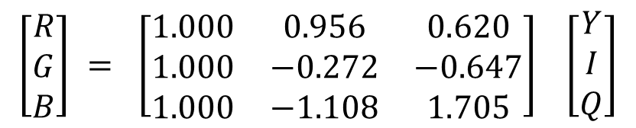
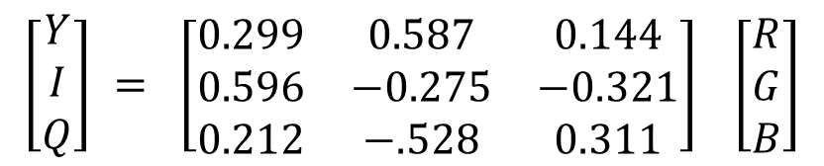
An RGB signal can be converted to a TV signal using an NTSC encoder which converts RGB values to YIQ values, as follows
$$\left[\begin{matrix}Y \\ I \\ Q\end{matrix}\right] = \left[\begin{matrix}0.299 & 0.587 & 0.144 \\ 0.596 & −0.275 & −0.321 \\ 0.212 & −.528 & 0.311\end{matrix}\right] \left[\begin{matrix}R \\ G \\ B\end{matrix}\right]$$
An NTSC video signal can be converted to an RGB signal using an NTSC encoder which separates the video signal into YIQ components, the converts to RCB values, as follows:
$$\left[\begin{matrix}R \\ G \\ B\end{matrix}\right] = \left[\begin{matrix}1.000 & 0.956 & 0.620 \\ 1.000 & −0.272 & −0.647 \\ 1.000 & −1.108 & 1.705\end{matrix}\right] \left[\begin{matrix}Y \\ I \\ Q\end{matrix}\right]$$

Slide 36
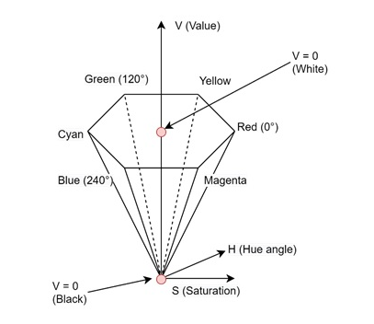
HSV Color model
The HSV model uses color descriptions that have a more interactive appeal to a user.
Color parameters in this model are hue (H), saturation (S), and value (V).
The boundary of the hexagon represents the various hues, and it is used as the top of the HSV hexcone.
In the hexcone, saturation is measured along a horizontal axis, and value is along a vertical axis through the center of the hexcone.
Hue is represented as an angle about the vertical axis, ranging from 0⁰ at redthrough 360⁰ . Vertices of the hexagon are separated by 60⁰ intervals.

Slide 37
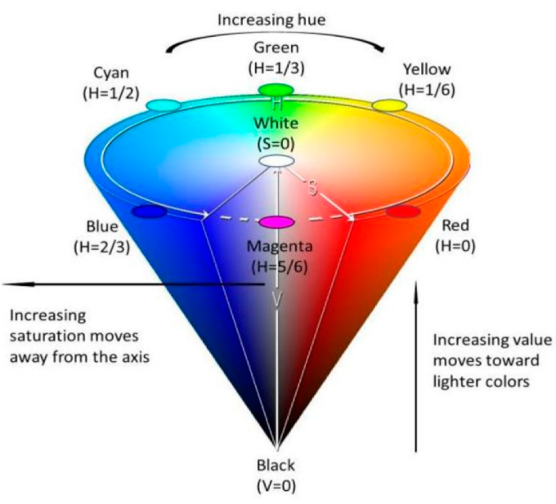
HSV
The 3D representation of the HSV model is derived from the RGB cube.
The outline of the cube has the hexagon shape.

Slide 38
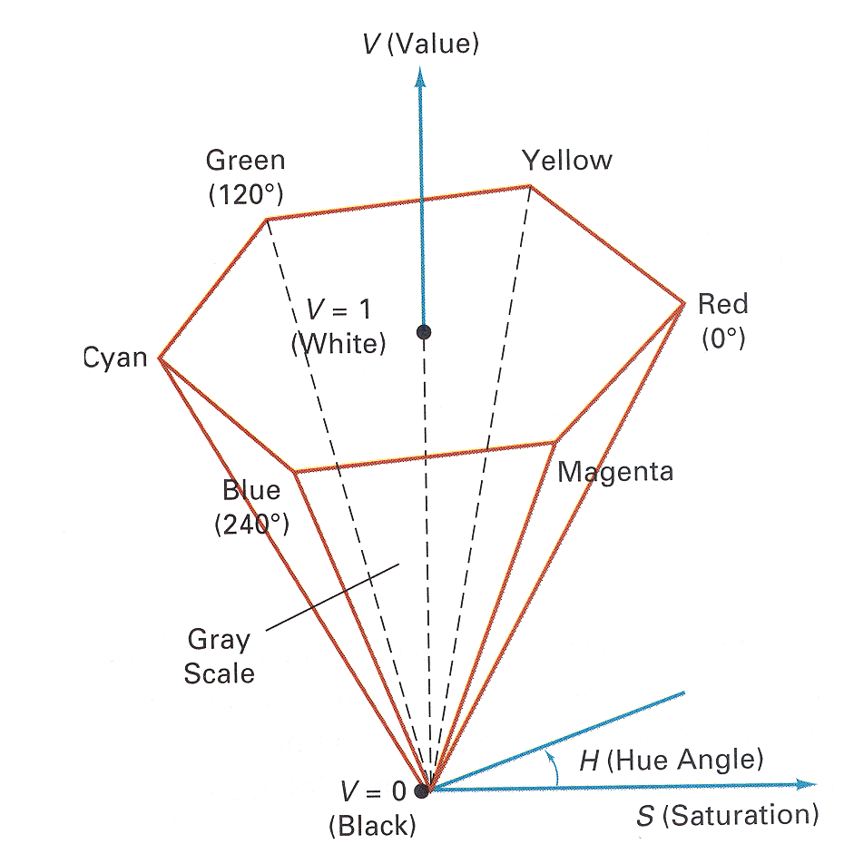
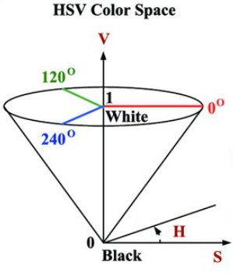
Yellow is at 60⁰ , green at 120⁰ and cyan opposite red at H = 180⁰. Complementary colors are 180⁰ apart.
Saturation S varies from 0 to 1. the maximum purity at S = 1, at S = 0.25, the hue is said to be one quarter pure, at S = 0, we have the gray scale.
Value V varies from 0 at the apex to 1 at the top.
- the apex representation black.
At the top of the hexcone, colors have their maximum intensity.
When V = 1 and S = 1 we have the pure" hues.
White is the point at V = 1 and S = 0.

Slide 39
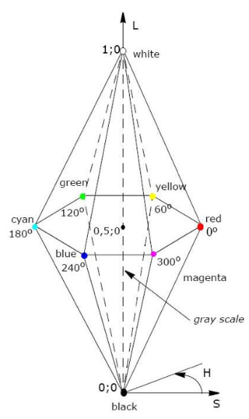
HLS color model
Color has three main characteristics −
Hue − This is the dominant wavelength of light we perceive. It is what we typically mean when we name a color like "red" or "blue".
Saturation − This refers to the purity of the color. A highly saturated color is vivid, while a less saturated color appears more muted.
Luminance − This is the lightness or intensity of the color. It determines how bright or dark a color appears.

Slide 40
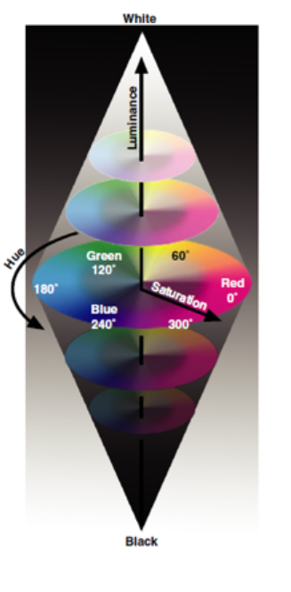
HLS color model
HLS model is based on intuitive color parameters used by Tektronix.
It has the double cone representation shown in the below figure. The 3 parameters in this model are called Hue (H), lightness (L) and saturation (s).
Hue specifies an angle about the vertical axis that locates a chosen hue.
In this model H = θ⁰ corresponds to Blue.
The remaining colors are specified around the perimeter of the cone in the same order as in the HSV model.
Magenta is at 60⁰, Red in at 120⁰, and cyan in at H = 180⁰
The vertical axis is called lightness (L).
At L = 0, we have black, and white is at L = 1
Gray scale in along the L axis and the “pure hues” on the L = 0.5 plane.
Saturation parameter S specifies relative purity of a color. S varies from 0 to 1 pure hues are those for which S = 1 and L = 0.5
As S decreases, the hues are said to be less pure.
At S= 0, it is said to be gray scale.

Slide 41
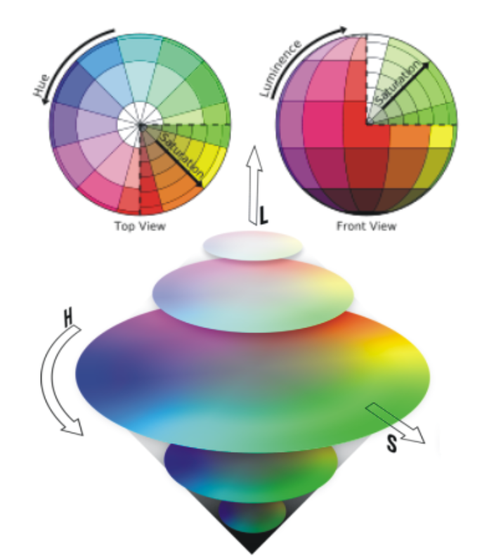
HLS color model

Slide 42
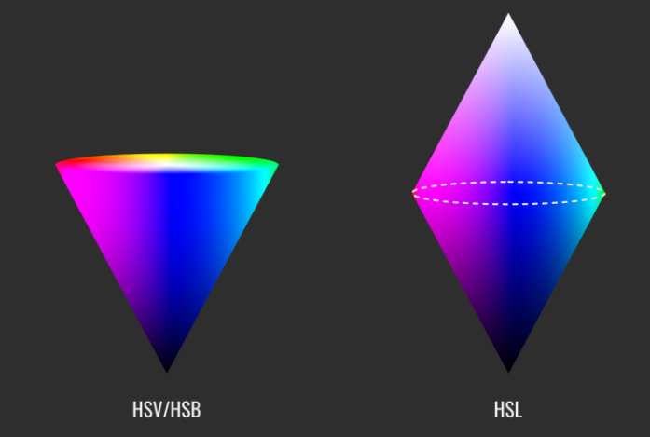
HSV (or HSB) vs HSL
presented as cones and bi-cones respectively

Slide 43
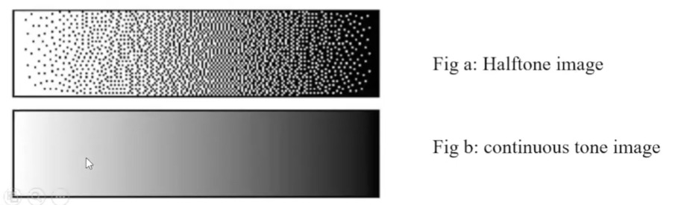
Halftoning and dithering
are image processing techniques
that simulate shades of gray or color using only two colors (usually black and white or a limited palette)
by varying the size, spacing, or pattern of dots or pixels

Slide 44
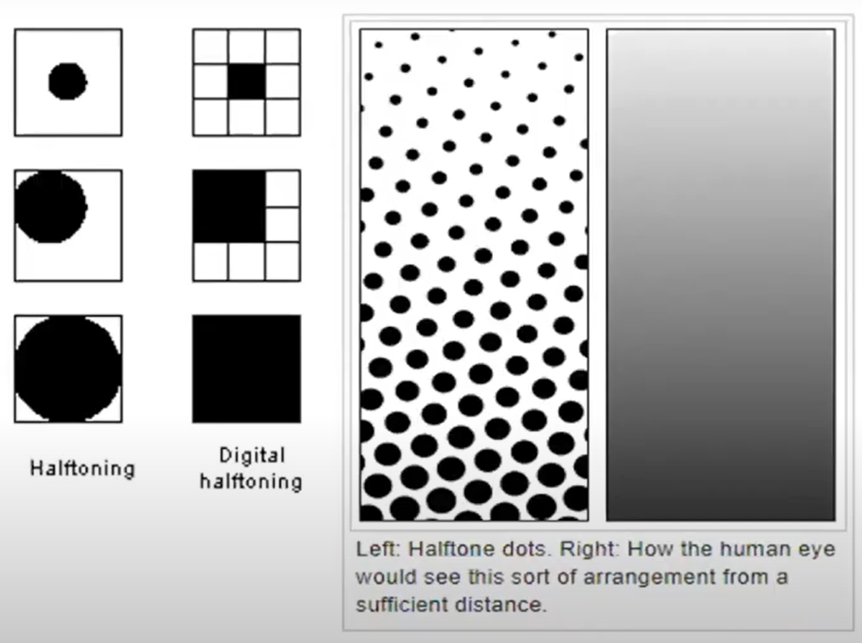
Halftone

Slide 45
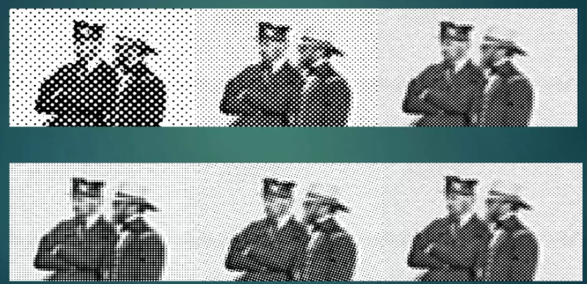
Half-toning
is a technique that simulates shades of gray by using patterns of dots
originated in printing technology
Dot-size

